Slide 1

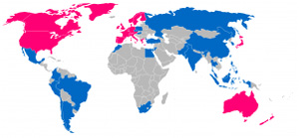







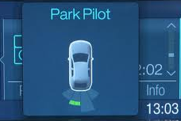

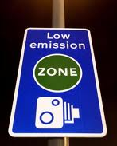

2.1 Forces at Work & Executive Priorities
Market Disruptors
Business Drivers
Anticipating consumer demand
Focus Areas for Key Executives
Capabilities
Macro trends
Increasingly complex supply chain
Identify factors such as fluctuating fuel prices and general economic conditions that have an impact on sales and manufacturing.
Plan and Manage the Business
Maintain Market Intelligence
Develop and Test Products
Manage Suppliers
Manufacture and Distribute Products
Market and Sell Products
Support Products and Customers
Increasing Urbanization
Fluctuating Interest Rates/ Market Uncertainty
Demand in Emerging Economies
Expansion into new markets
Increased focus on volume from emerging markets
Establish and expand operations in new markets to maintain revenue growth.
Globalization of Supply Chain
Rising Oil and Material Costs
Changing Consumer Buying Patterns
Shrinking geographic footprint (e.g., consolidation of dealerships)
Optimizing distribution channels (service and sales)
Build access to online consumers, offer convenient service options.
Consolidate operations
Increased mergers and acquisitions
Integrate operations to gain economies of scale and realize benefits of operational synergy.
Technology
Reduce costs in manufacturing
High-Performance Computing (e.g., Virtual Prototyping)
Alternative Fuels/ Electric Vehicles
Technology Design Differentiation
(e.g., Anti-sleep, Collision detection, iPhone integration, etc.)
Demand volatility
Utilize innovative ways to reduce costs (e.g., robotics, inventory storage, shared R&D).
Improving supply chain links
Rising raw material costs
Put in place supply chain management systems and processes to minimize inventory storage and carrying costs
Social Media (two-way marketing channel)
Integrated product development
Increased demand for new models (e.g., hybrids, EV)
Reduce time-to-market for new products by exchanging information among design, manufacturing, safety, and marketing groups.
Use digital marketing
Increased emphasis on brand loyalty (protect market share)
Reach and influence consumers directly with digital marketing, including social media.
Regulation
Increasing Environmental Regulation
(e.g., MPG requirements, carbon emission)
Increased Safety Standards (Pedestrian and Auto)
Tax Incentives
Improve after-sales service
Increased demand for integrated high-tech electronics
Accentuate service delivery as a way to differentiate product, bolster customer loyalty, and increase revenue.
Consumer-driven and tailored electronics deployment
Increased requirement for fuel-efficient and low-emission vehicles
Gen Y tends to see a car as a "personal technology cocoon.“ Significant pressure for manufactures to deliver a tailored in-cabin experience.
Regulatory compliance
Cost of compliance with governmental regulations
Comply with legislation that impacts costs, including fuel efficiency mandates, stricter
environmental standards, and safety regulations.
Source: First Research, IBIS Microsoft Analysis

